Slide 1
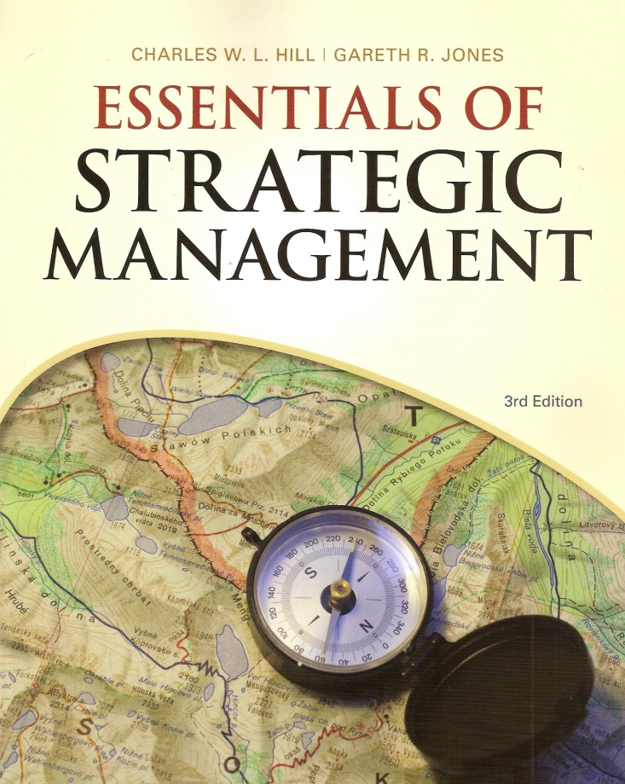
Building Competitive Advantage
Essentials of Strategic Management, 3/e
Charles W.L. Hill | Gareth R. Jones
Chapter 4

Slide 2
Success and Strategy
Within an industry some companies outperform others.
What is the basis of their competitive advantage?

Slide 3
Competitive Advantage
Occurs when a company’s profitability is greater than the industry’s average profitability
Competitive advantage over several years is considered Sustained

Slide 4
Company Profitability
Two basic conditions:
Amount of Value that customers place on a good or service
  Value creation is at the heart of competitive advantage
  The greater the value customers place on a product, the more the company can charge.
  A product’s price is usually less than the value placed on it by the average customer.
  This causes customers to capture consumer surplus.

Slide 5
Company Profitability (cont’d)
The company’s cost of production
  A company will look for ways to increase productivity of capital and labor through:
    Economies of Scale
    Spread fixed cost over large product volume
    Greater division of labor and specialization

Slide 6
Two Basic Strategies for Creating Value
Low Cost- Drive down cost structure
Differentiation- Consumers value the product and are willing to pay a premium price

Slide 7
Building Competitive Advantage
Four Factors:
  Efficiency
  Quality
  Innovation
  Customer Responsiveness
These are the generic building blocks of competitive advantage that any company in any industry can adopt.
Notes:
Insert figure 4.3

Slide 8
Efficiency
Efficiency = outputs/inputs
Employee Productivity: output per employee
Capital Productivity: Output per unit of investment capital
High Productivity = greater efficiency and low costs

Slide 9
Quality as Excellence
Superior Quality: customers perceive attributes of a product to be better than rival’s attributes, including:
  Design
  Style
  Aesthetic appeal
  Features and functions
  Level of service that comes with the product
Excellence: when excellence is built into product offering, consumers have to pay more to own or consume the product

Slide 10
Quality as Reliability
A product is reliable if it:
  Consistently does the job it was designed for
  Does the job well
  Rarely, if ever, breaks down
Less time is spent of defective products and fixing mistakes
Reliability increases the value a consumer gets from the product and increases the price that the company can charge

Slide 11
Innovation
The act of creating new products or processes
  Innovations give a company something unique that their competitors lack
  In the long run, innovation is perhaps the most important part of competitive advantage

Slide 12
Innovation (cont’d)
Product Innovation- The development of products that are new to the world or have superior attributes to existing products.
Process Innovation-The development of a new process for producing products and delivering them.

Slide 13
Customer Responsiveness
If a customer’s need is satisfied better by a certain product, the customer will attribute more value to the product.
More value creates a differentiation and ultimately a competitive advantage

Slide 14
The Value Chain
Idea that a company is a chain of activities for transforming inputs into outputs that customers value
Consists of primary and support activities

Slide 15
Primary Activities
Research and Development
Production
Marketing and Sales
Customer Service

Slide 16
Support Activities
Provide inputs for primary activities
  Material Management (logistics)
  Human Resources
  Information Systems
  Company Infrastructure

Slide 17
Functional Level Strategies
Managers pursue improvement in business functions by:
  Increasing efficiency
  Increasing quality
  Increasing innovation
  Achieving superior customer responsiveness

Slide 18
Distinctive Competencies
A unique firm-specific strength that allows a company to better differentiate or achieve lower cost than rivals
Arise from Resources and Capabilities

Slide 19
Resources
Financial, physical, social or human, technological, and organizational factors that create value to customers.
Can be Tangible or Intangible
Example:
Tangible = land, building, equipment
Intangible = brand names, reputations

Slide 20
Capabilities
A company’s skills at coordinating its resources and putting them into productive use.
Capacities are needed to utilize resources

Slide 21
Durability
When a company has superior profitability, other companies are inclined to imitate the successful strategy.
Durability of competitive advantage depends on the ease or difficulty to copy distinctive competencies.
Barriers of Imitation are the factors that make copying difficult for competitors.
Even if a company’s distinctive competencies are protected by higher barriers to imitation, it should act as if rivals are continually trying to nullify its source of advantage

